Slide 1

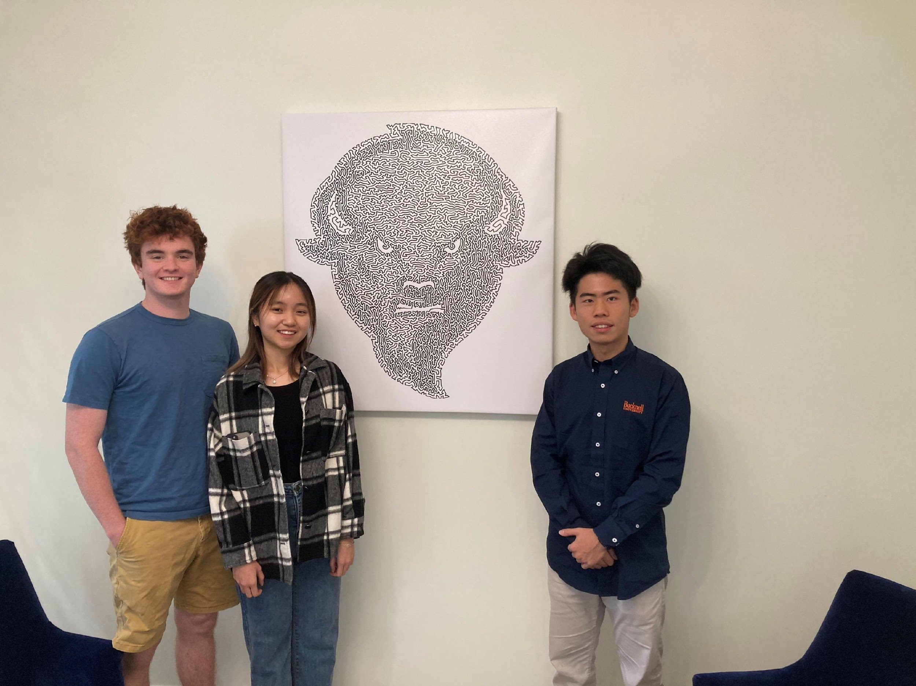
The Undeciders – Bucknell University
Group Members: Matthew Gallagher, Linh Nguyen, Kuo Gai (from left to right)
Faculty Mentor: Joseph Wilck

Slide 2
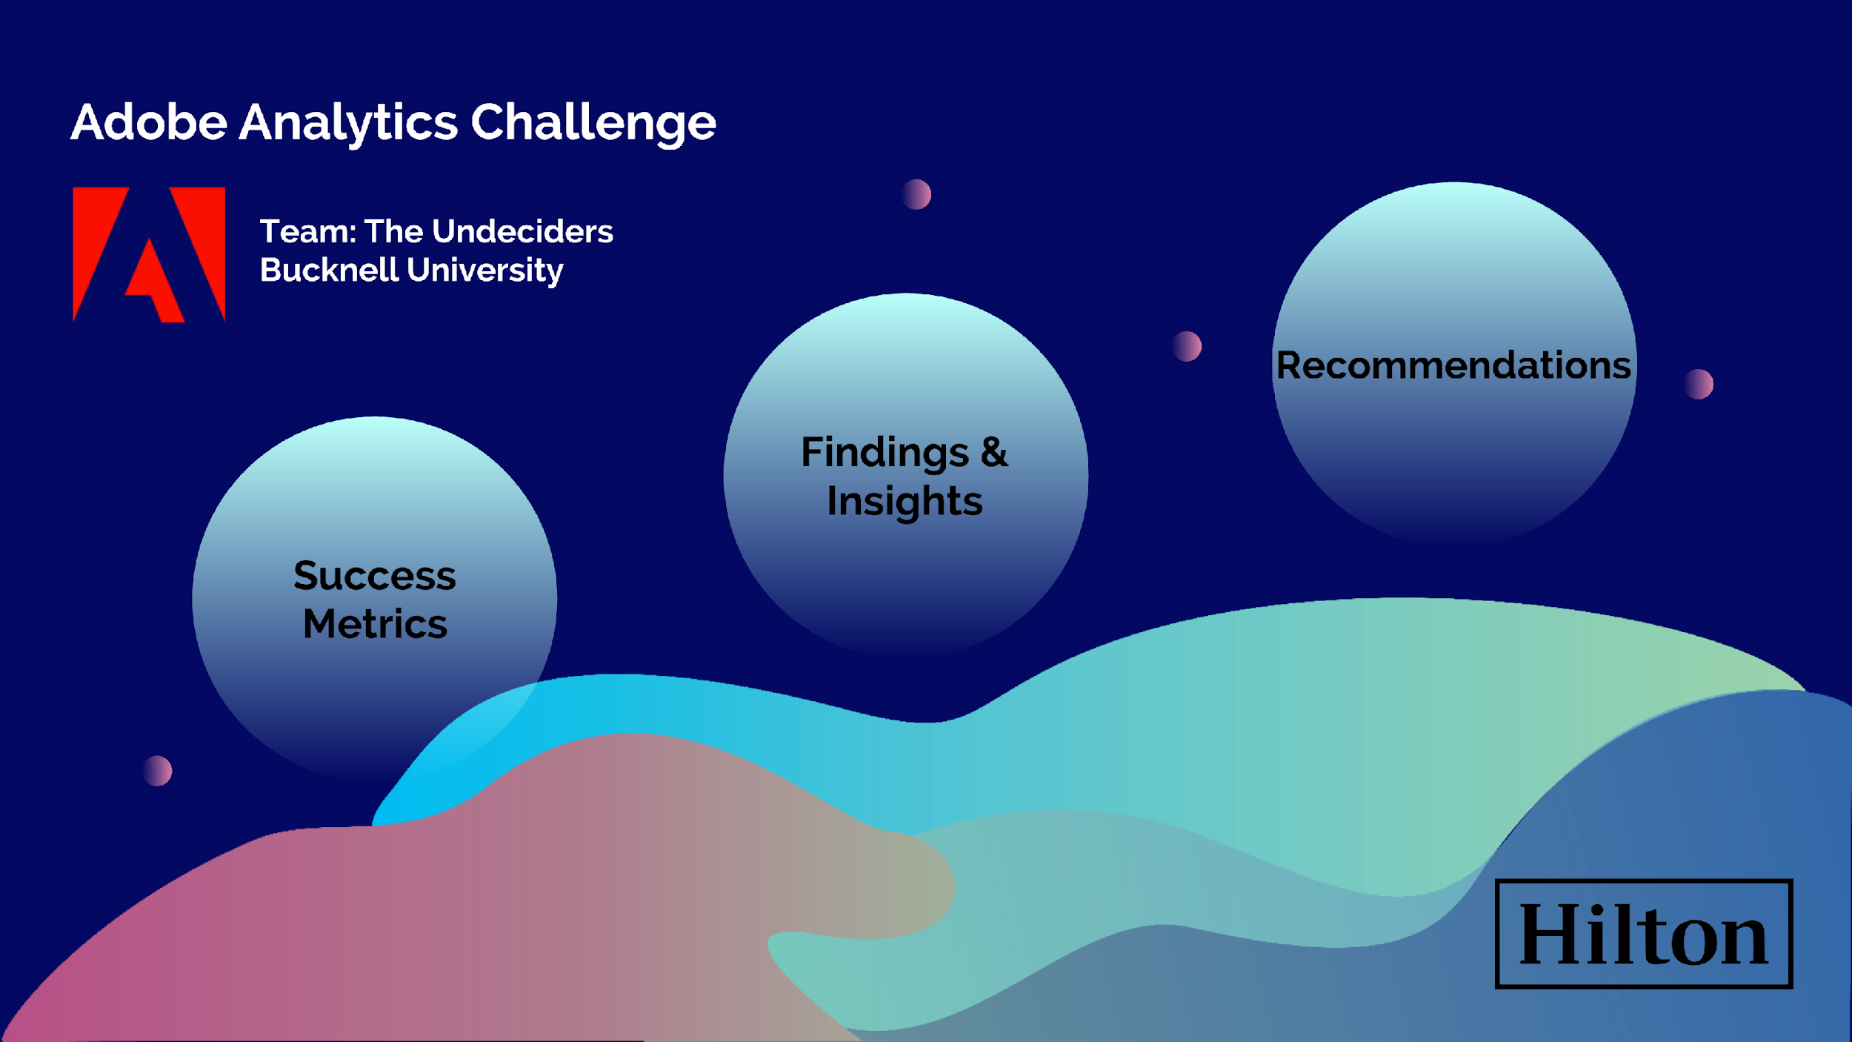

Slide 3
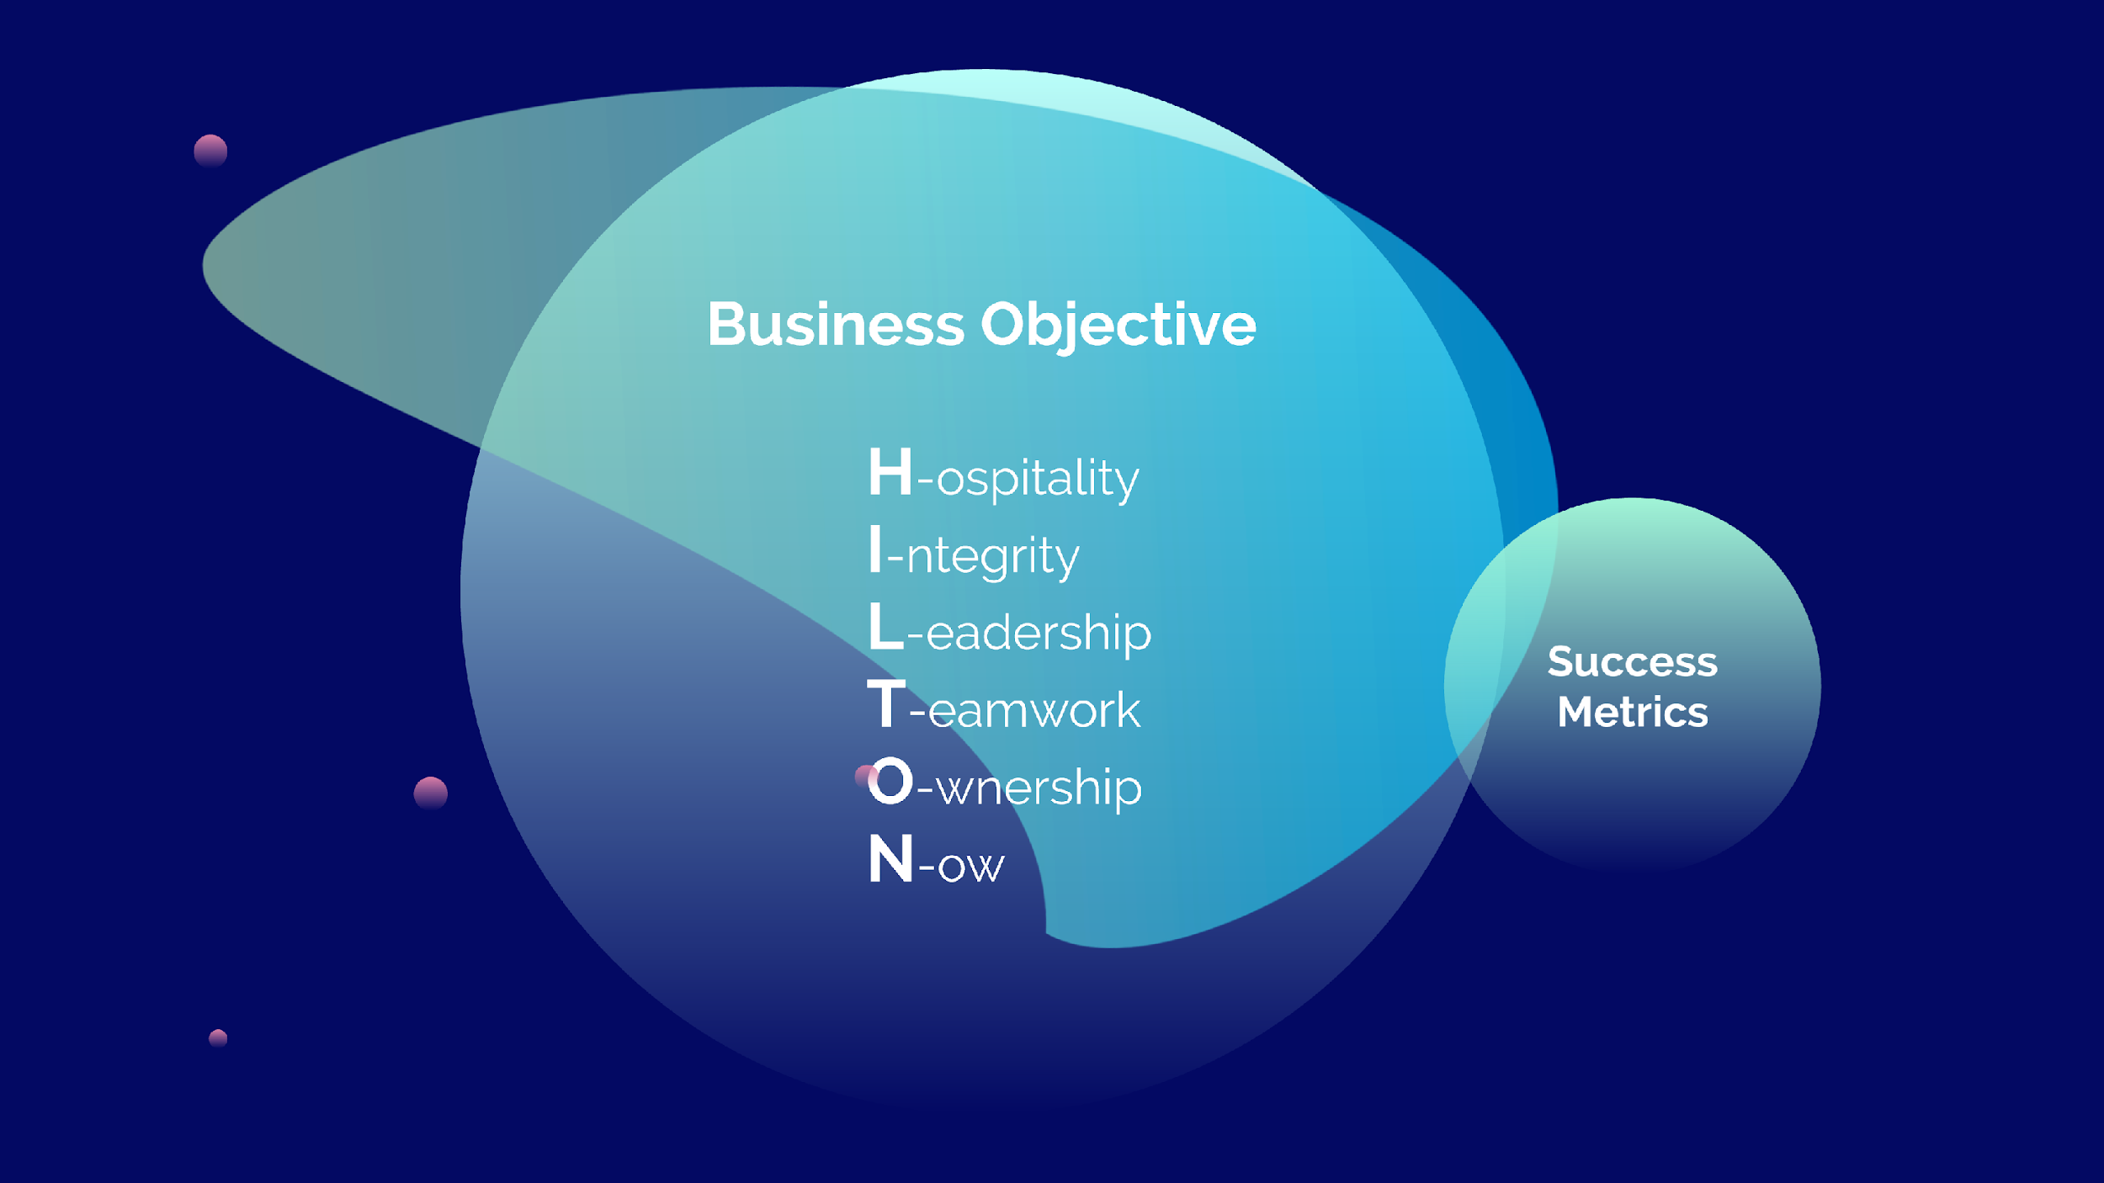
Notes:
We spent time to explore Hilton’s values and interests, and we decided to focus on the above 6 objectives throughout our analysis, such that we can present the most relevant insights to Hilton.
In the upcoming slides, we will highlight those objectives that are relevant to our findings.

Slide 4
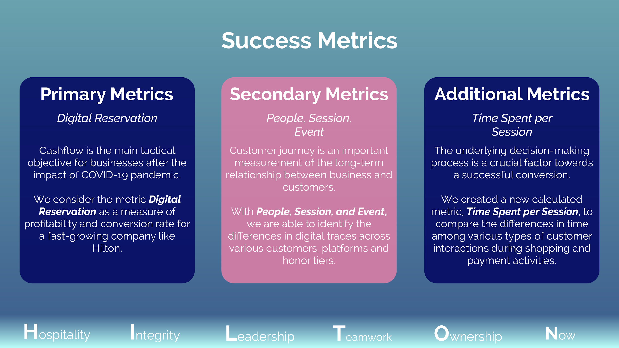
Notes:
Due to the time constraint, we decided to focus on what means the most to Hilton. We split the metrics available in Adobe CJA into primary & secondary metrics, and we created additional metrics (calculated fields) to further explore the data.
We will come back to these success metrics at the end of our presentation to better support our recommendations.

Slide 5
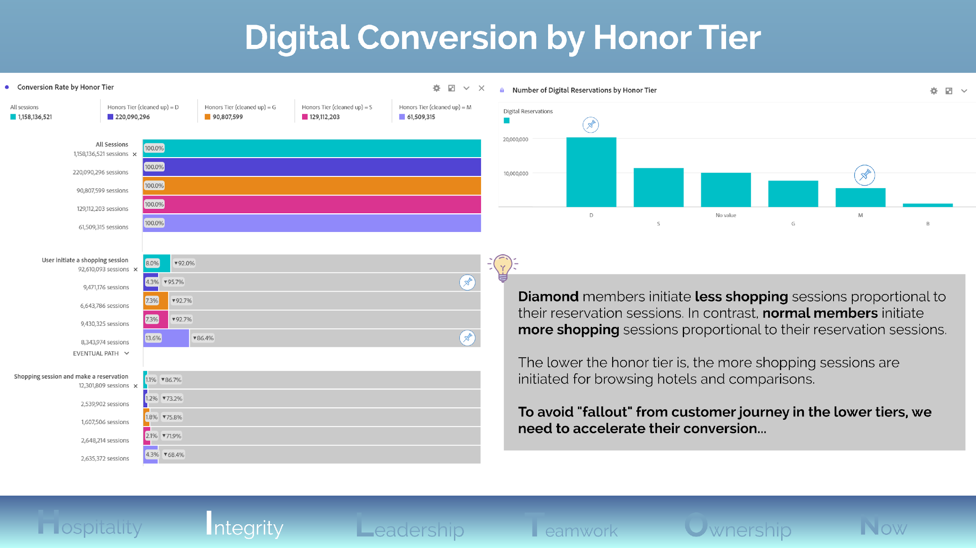
Notes:
In the first layer of the chart “Conversion Rate by Honor Tier”, we used filter to separate those sessions that contain any of the “searching”, “finding dates”, “browsing/viewing”, or making a reservation.
In the second layer, we duplicated the same filter but added another constraint that the “reservation confirmation” pages exist in that session.
The bar chart “Number of Digital Reservation by Honor Tier” purely focuses on the sum of digital reservations from each honor tier.

Slide 6
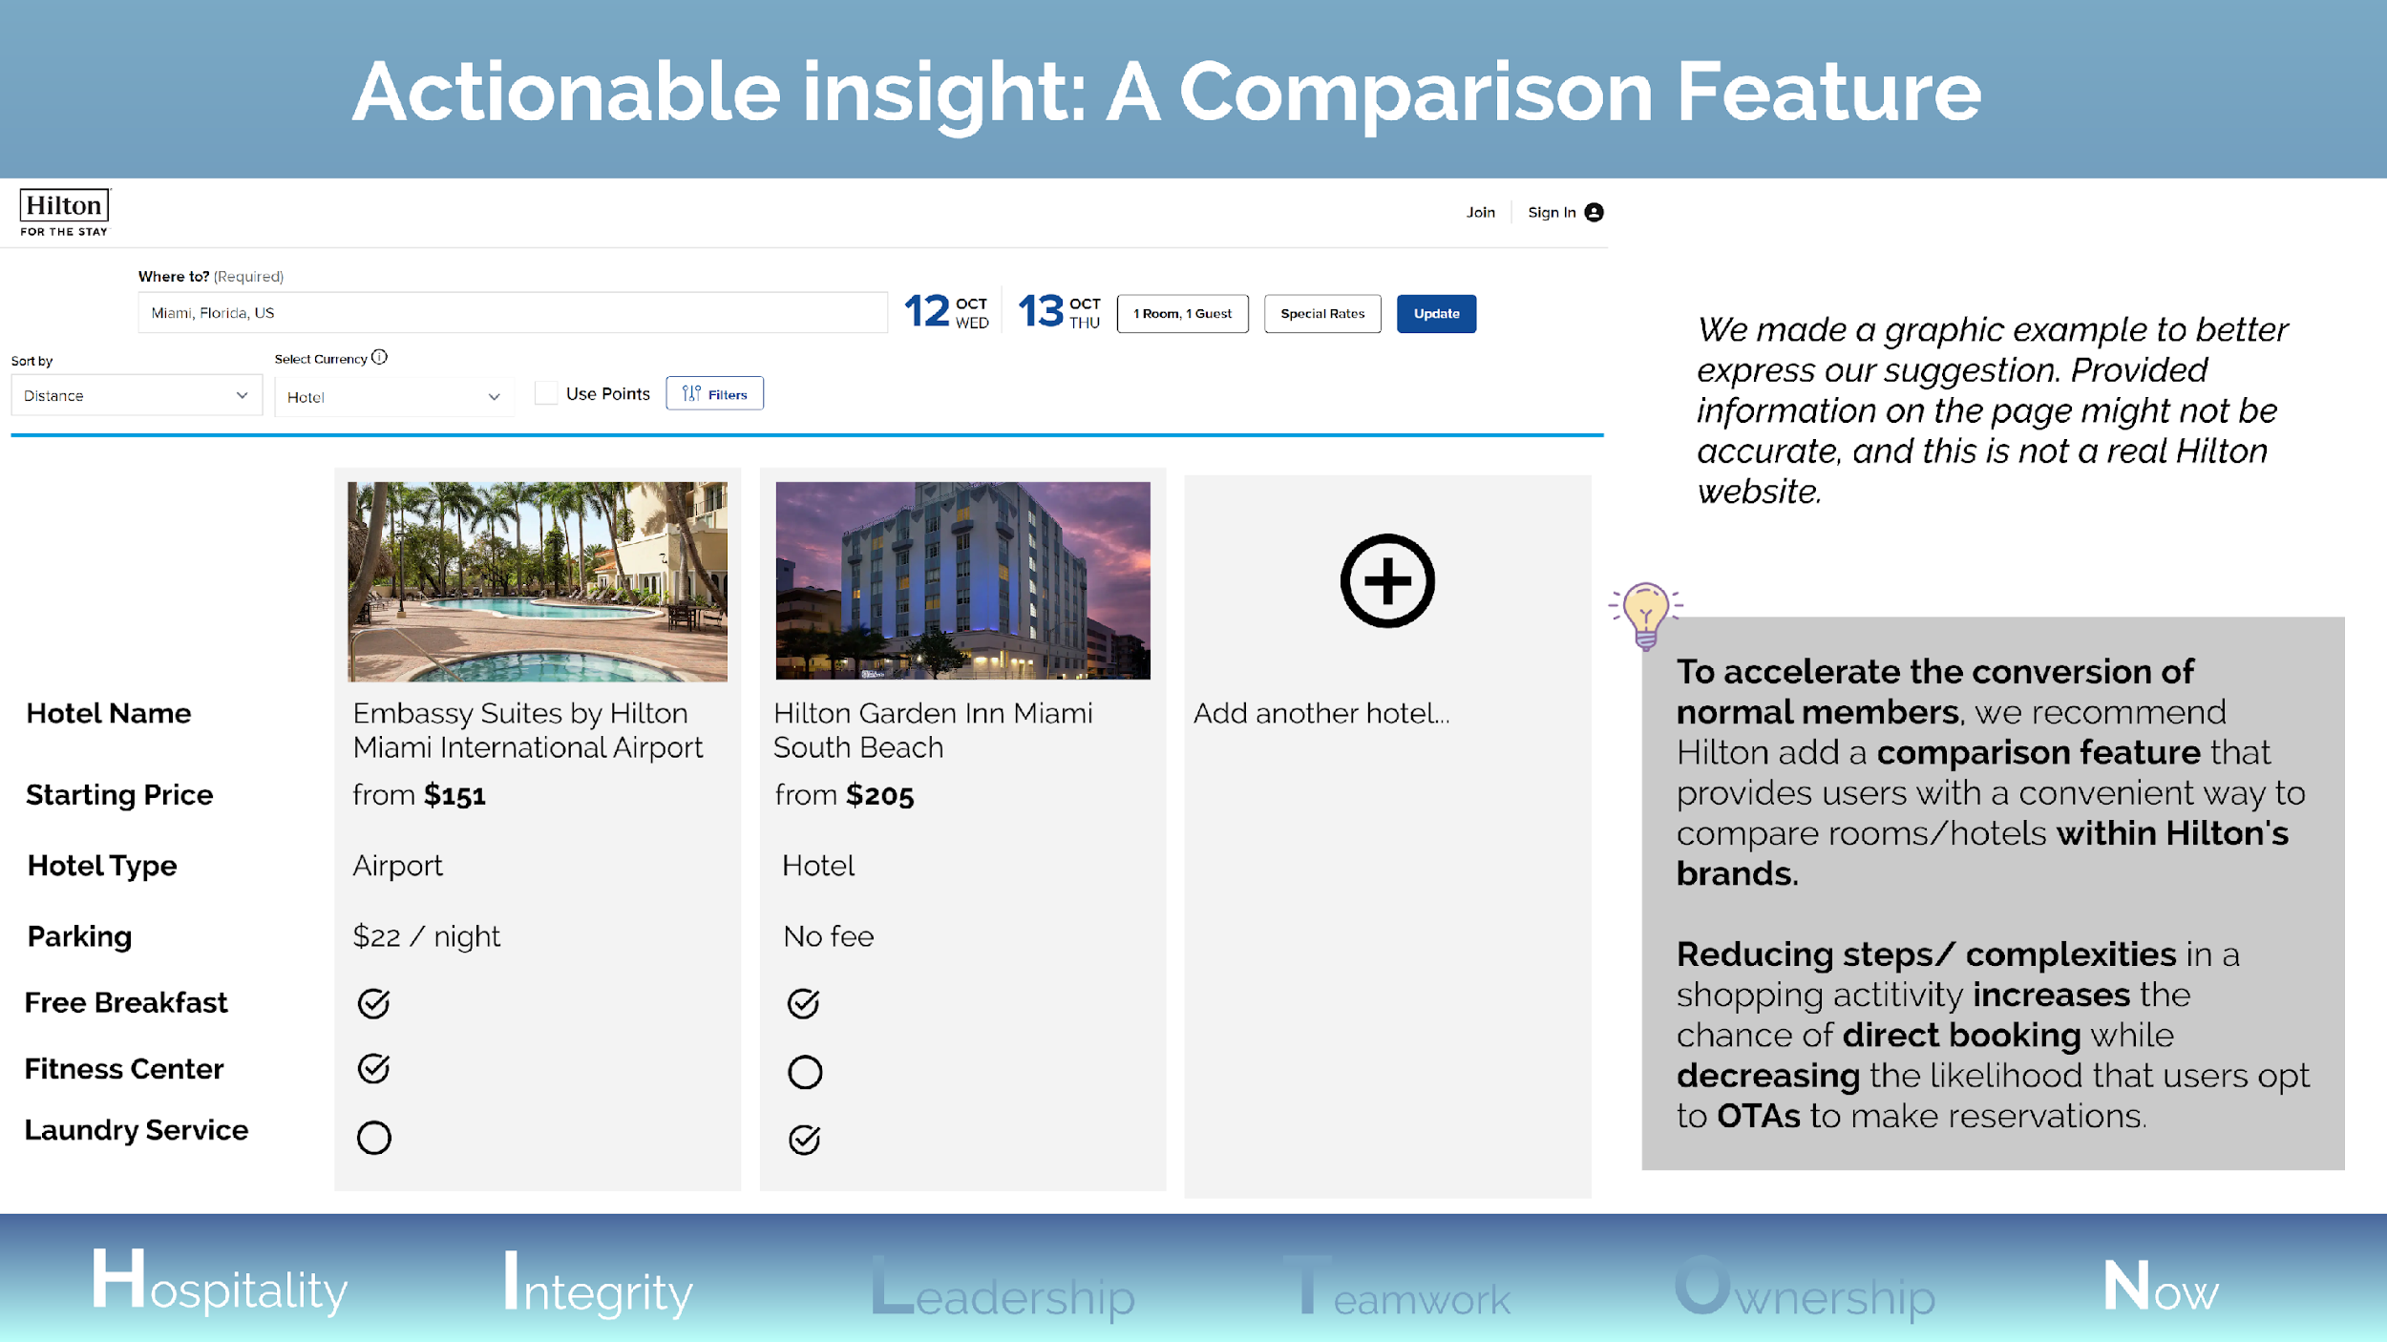
Notes:
We proposed that the reason why normal members have the most browsing sessions but the least digital reservations is that they are comparing among different sites for brands, prices, etc. (potentially with competitors and OTAs).
So that bringing this comparison feature in-house would help to retain direct booking from lower-tier members.

Slide 7
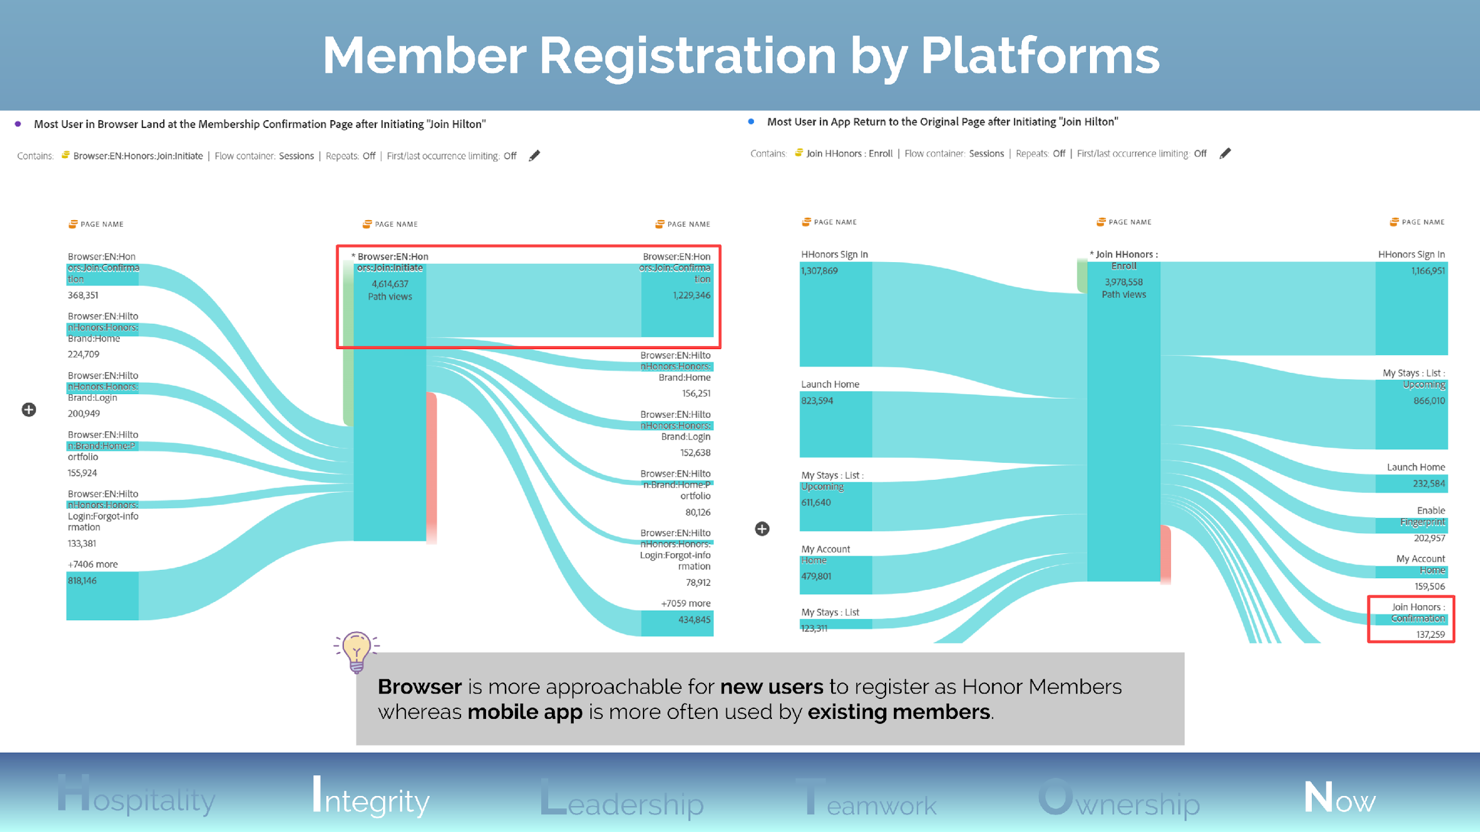
Notes:
On the left: “Browser:EN:Honors:Join:Initiate” is the browser page where user see the registration form. On the right: “Join HHonor: Enroll” is the equivalent on mobile app.

Slide 8
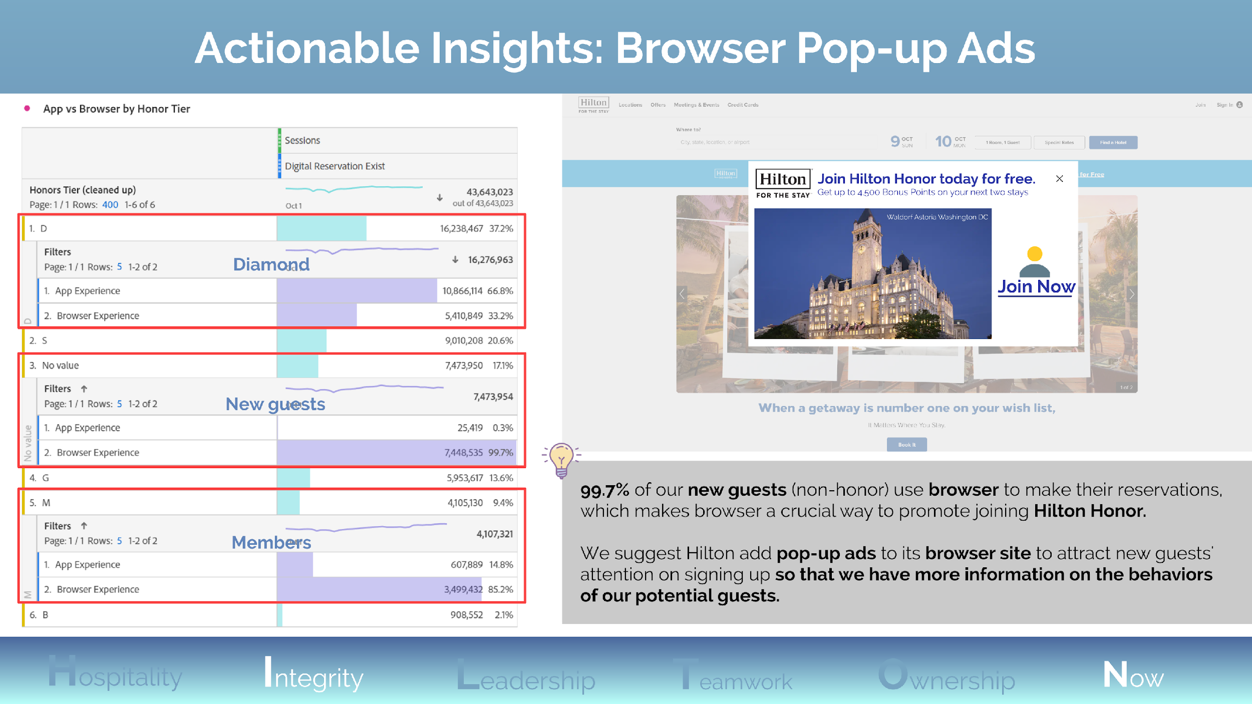
Notes:
- In the table, we break down sessions that contain digital reservations by honor tiers to further compare the difference in their preferences between app and browser.

Slide 9
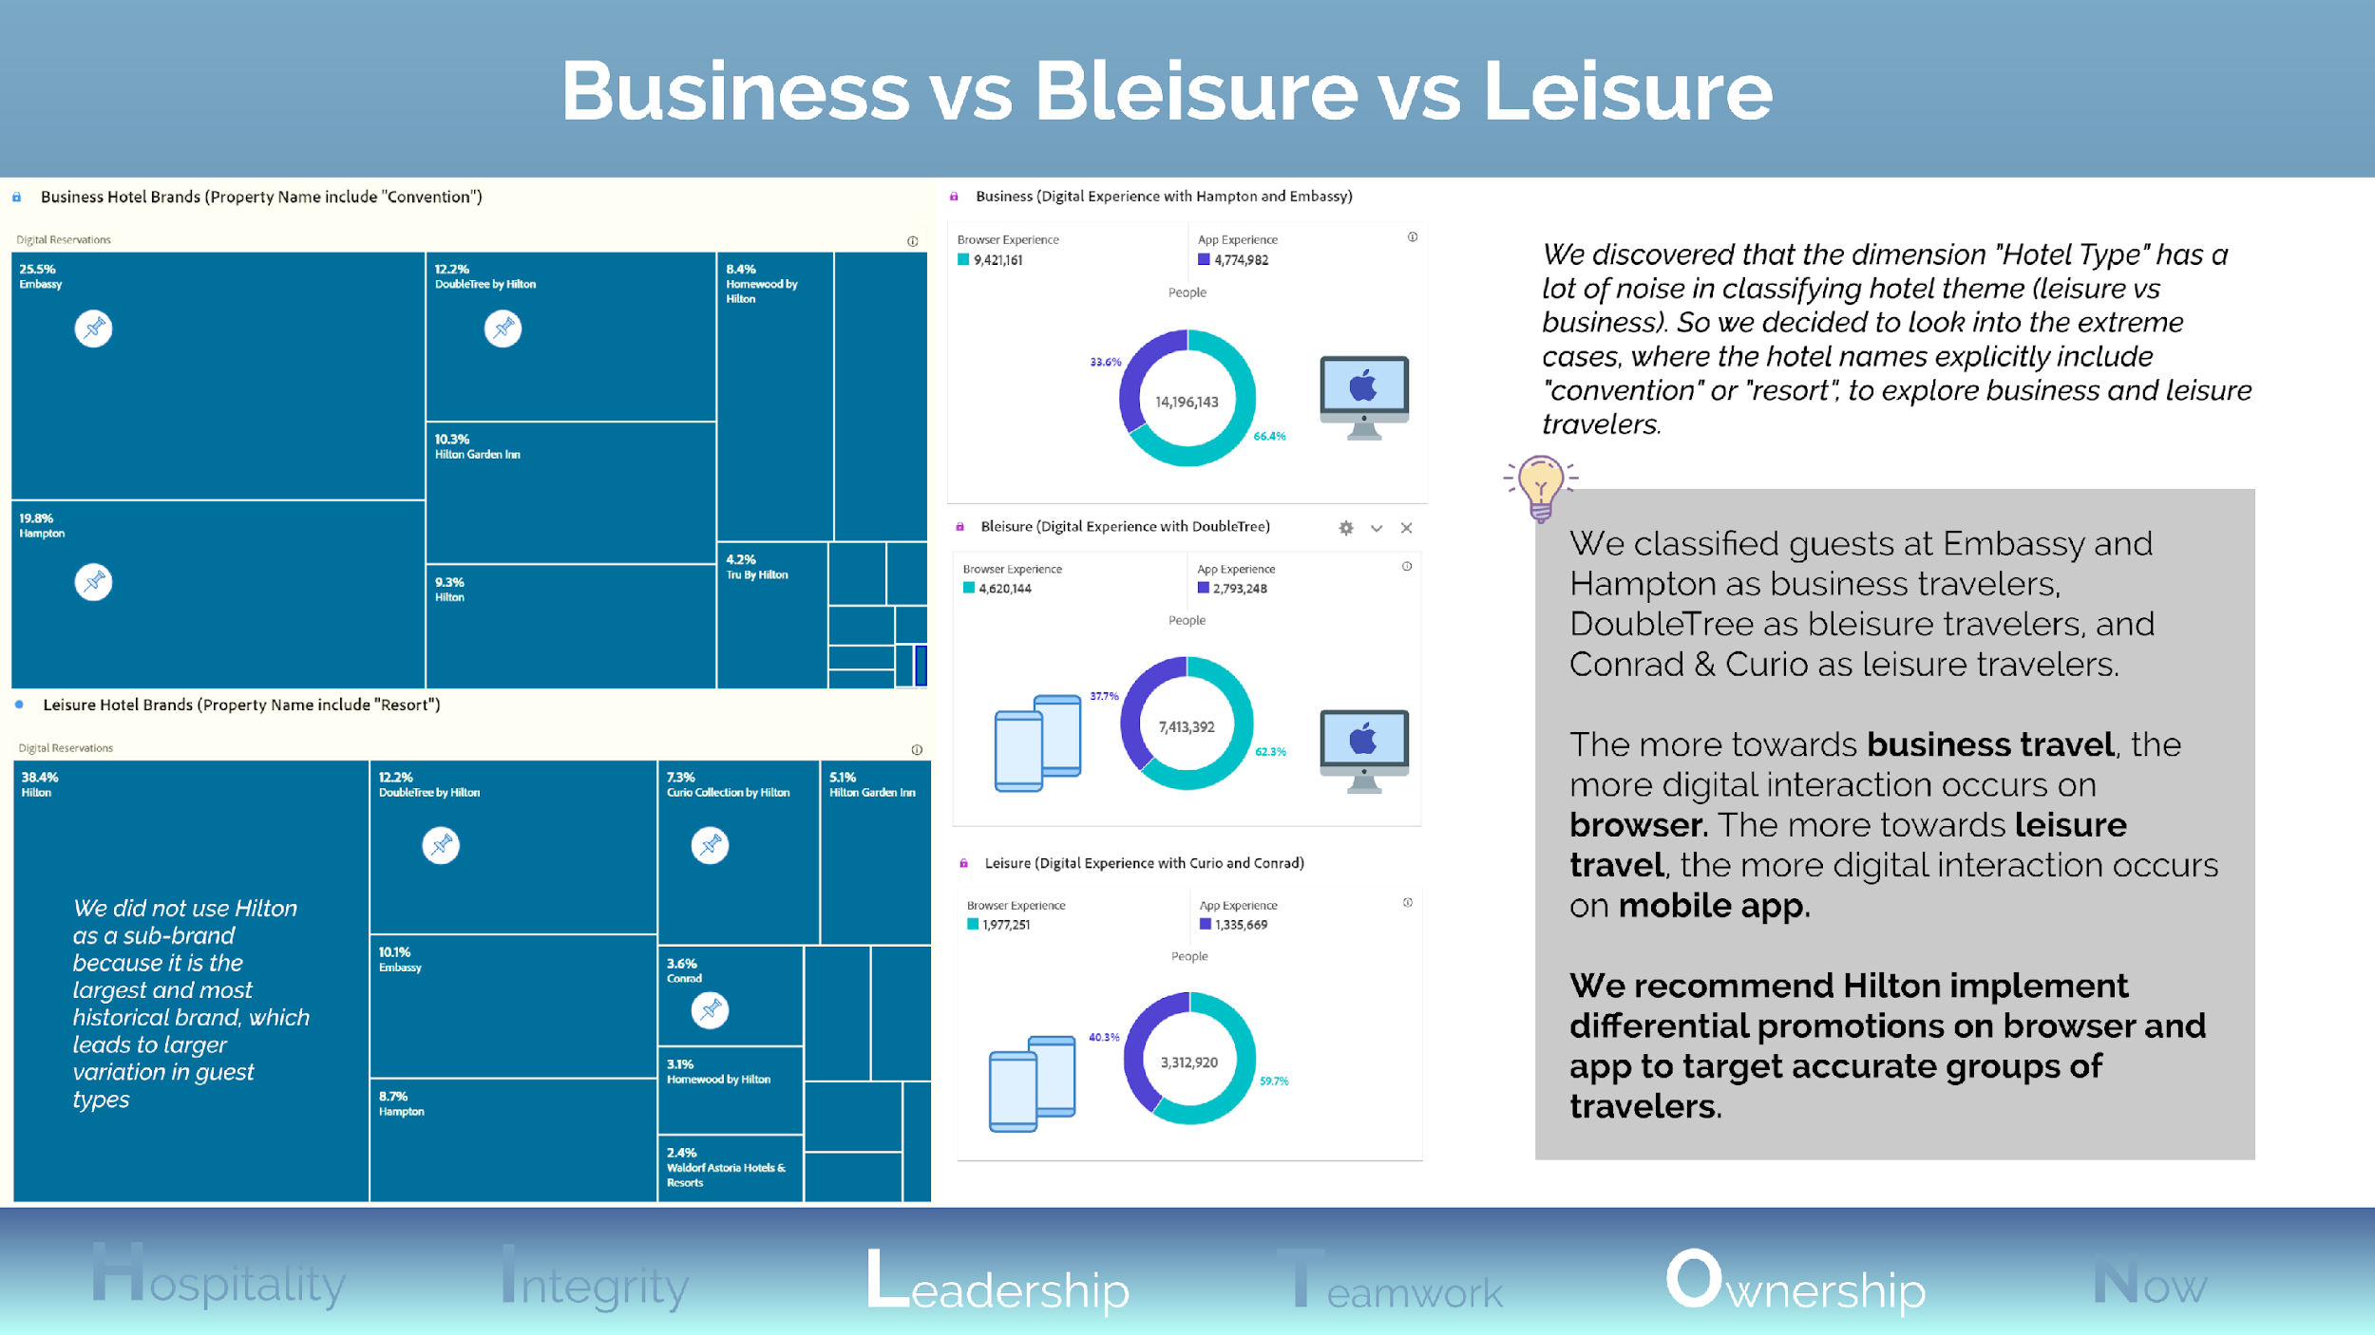
Notes:
In the tree maps, we extracted the top Hilton brands that own the most number of properties that contain “convention” or “resort” in their names.
We acknowledged that some app pages will redirect users to visit a browser page, but it does not affect our findings since those “app->browser” visits would be proportional to their app visits.

Slide 10
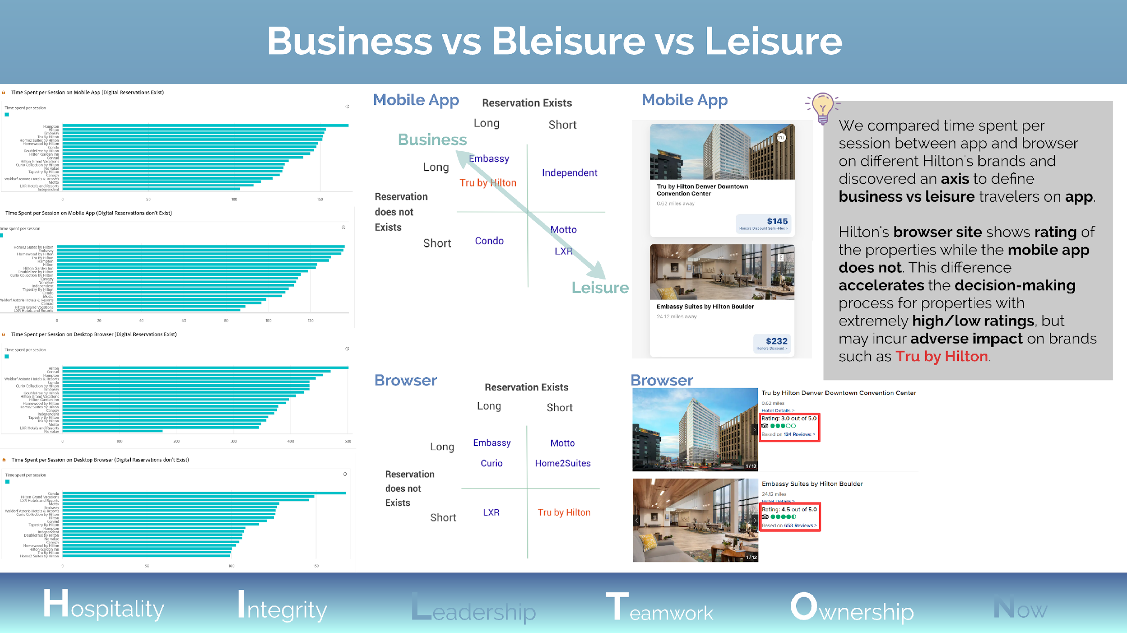
Notes:
We transposed data in the bar charts into the two matrices for the ease of comparison. Long and short indicate the time spent per session.
We highlighted Tru by Hilton because it’s an economy brand (low-price) with lower average rating across Hilton’s brands.

Slide 11
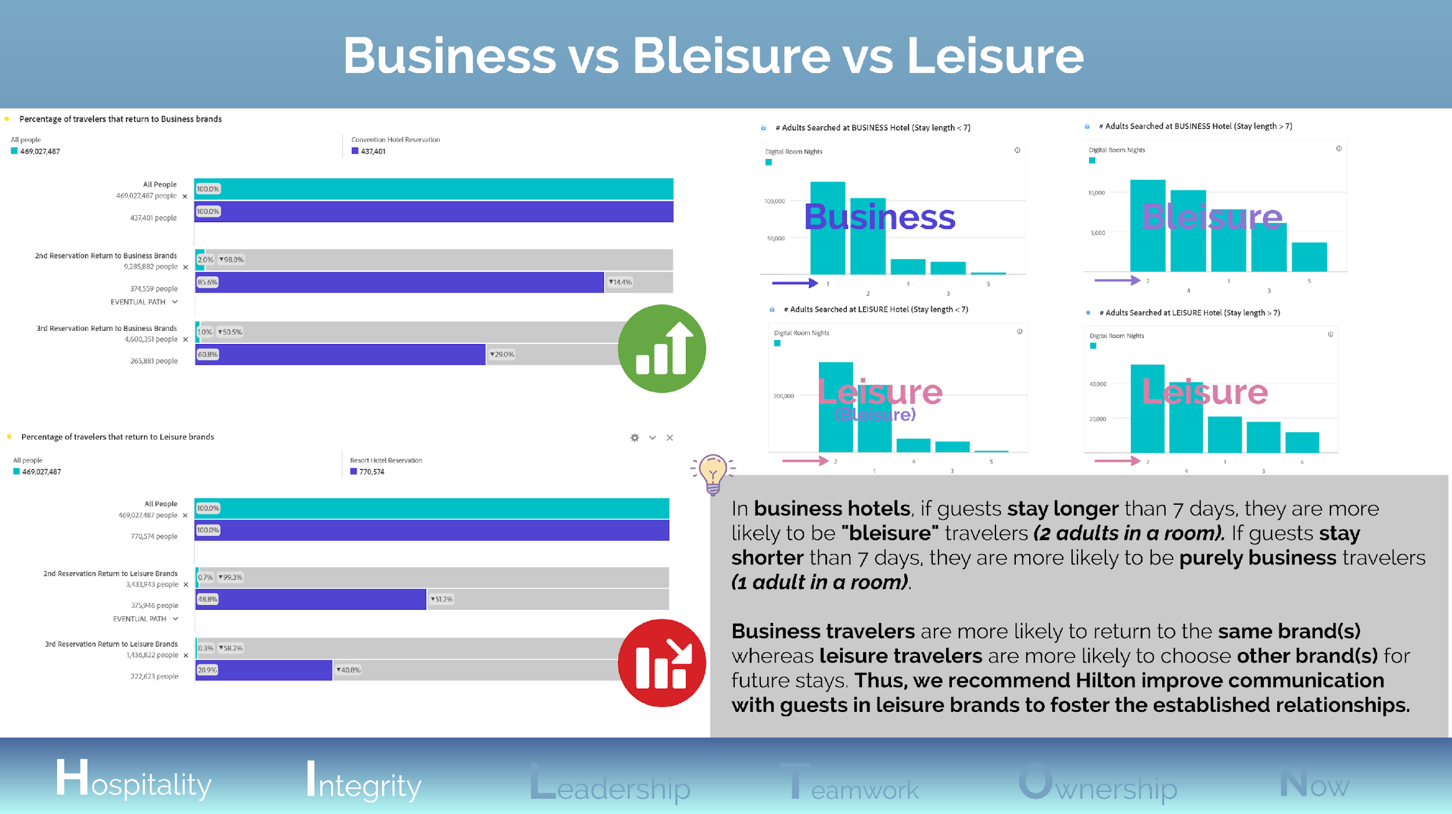
Notes:
In the four bar charts on the right, we classified business vs leisure hotels using the same ideology from previous findings (only look at the two extreme cases: hotel name include “convention” or “resort”)
We concluded that reservations at leisure hotels, with a stay length < 7, would be mostly leisure. But it could also be bleisure, because the difference between #2 adults searched and #1 adults searched is small.

Slide 12
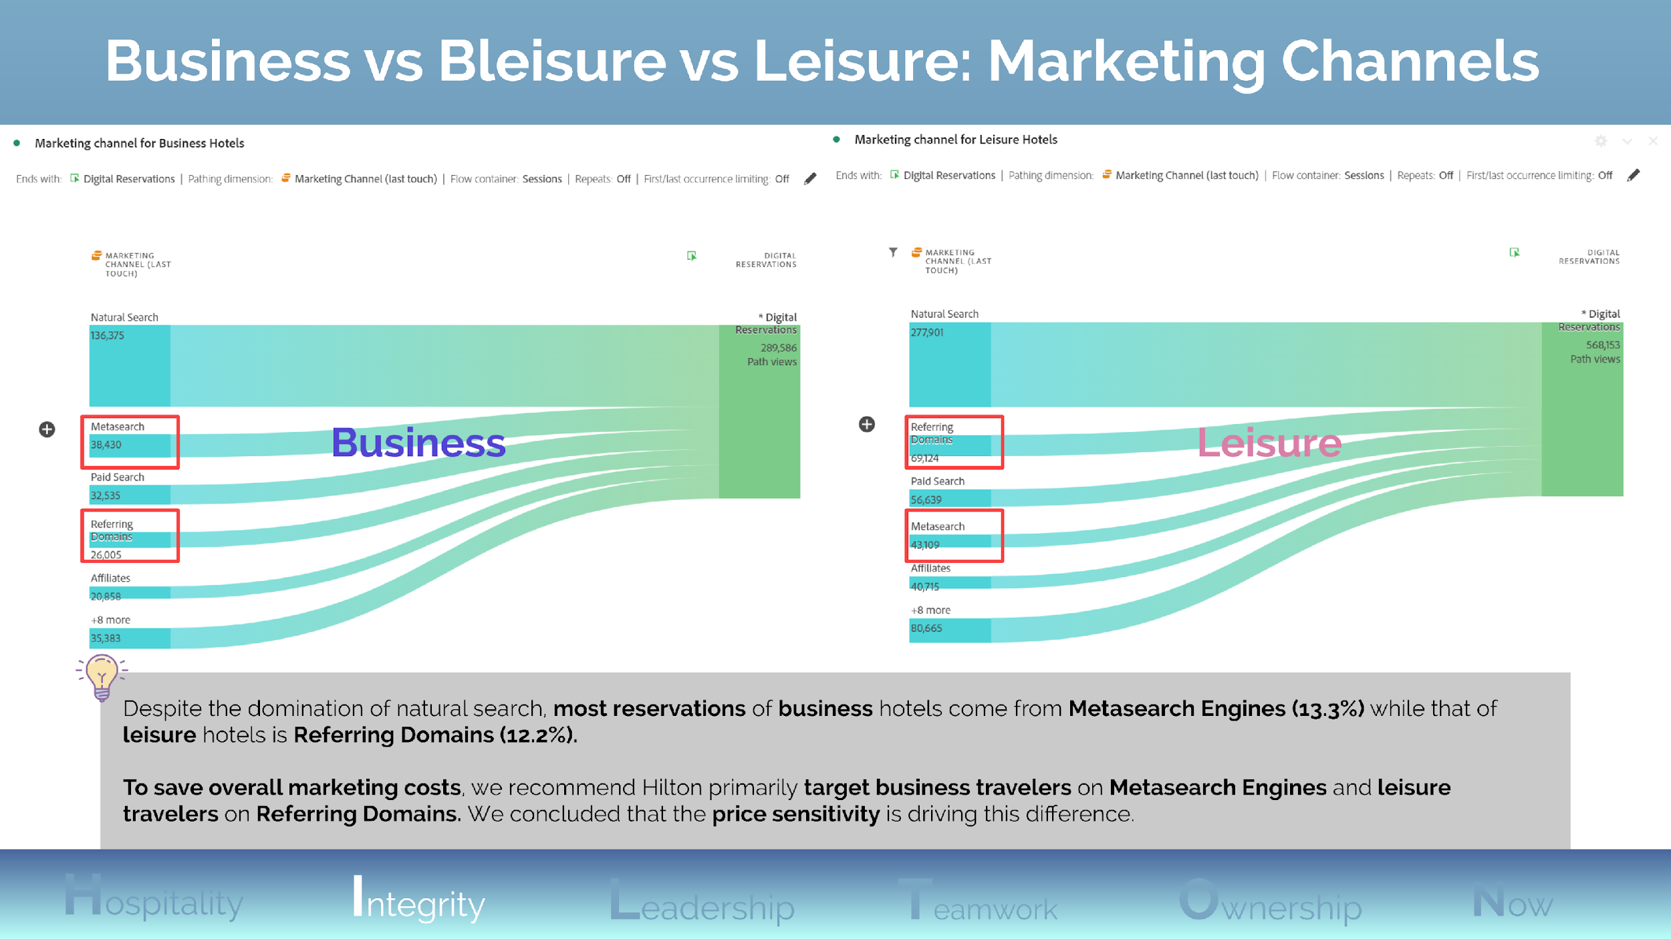
Notes:
The two flow charts show users’ last interaction with any of the marketing channels, before making a digital reservation through Hilton
Price sensitivity: Business travelers are usually given a budget for their stays, and Metasearch Engines can help them to compare prices. (As previously recommended, bringing the comparison feature in-house would substantially improve conversion)

Slide 13
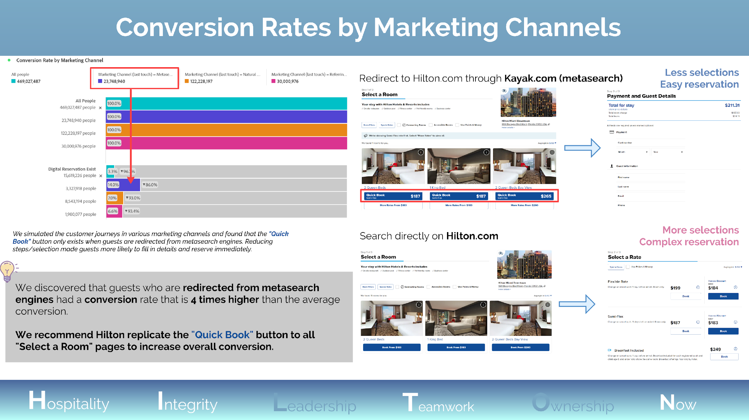
Notes:
We defined the customer journey for those users who are redirected from Metasearch Engines as “Less selection, Easy reservation” because the “Quick Book” button bypass the “Select a Rate” page by leading users directly to the “Payment and Guest Details” page.
The “Quick Book” button may display the “best match” pricing, by analyzing members’ past reservations and browsing behaviors.

Slide 14
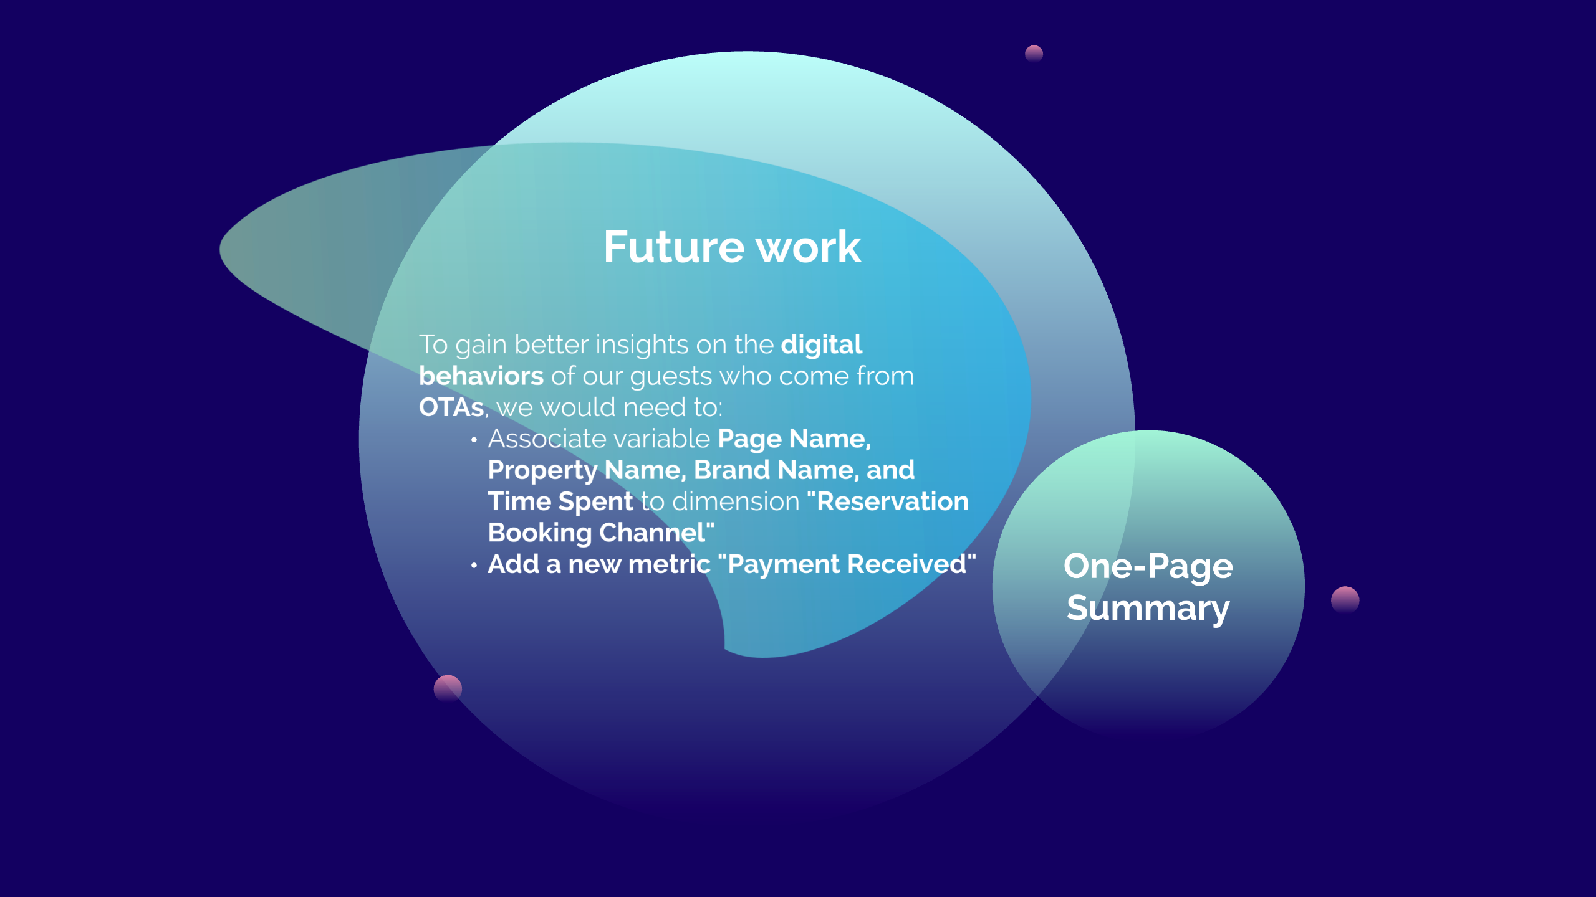

Slide 15
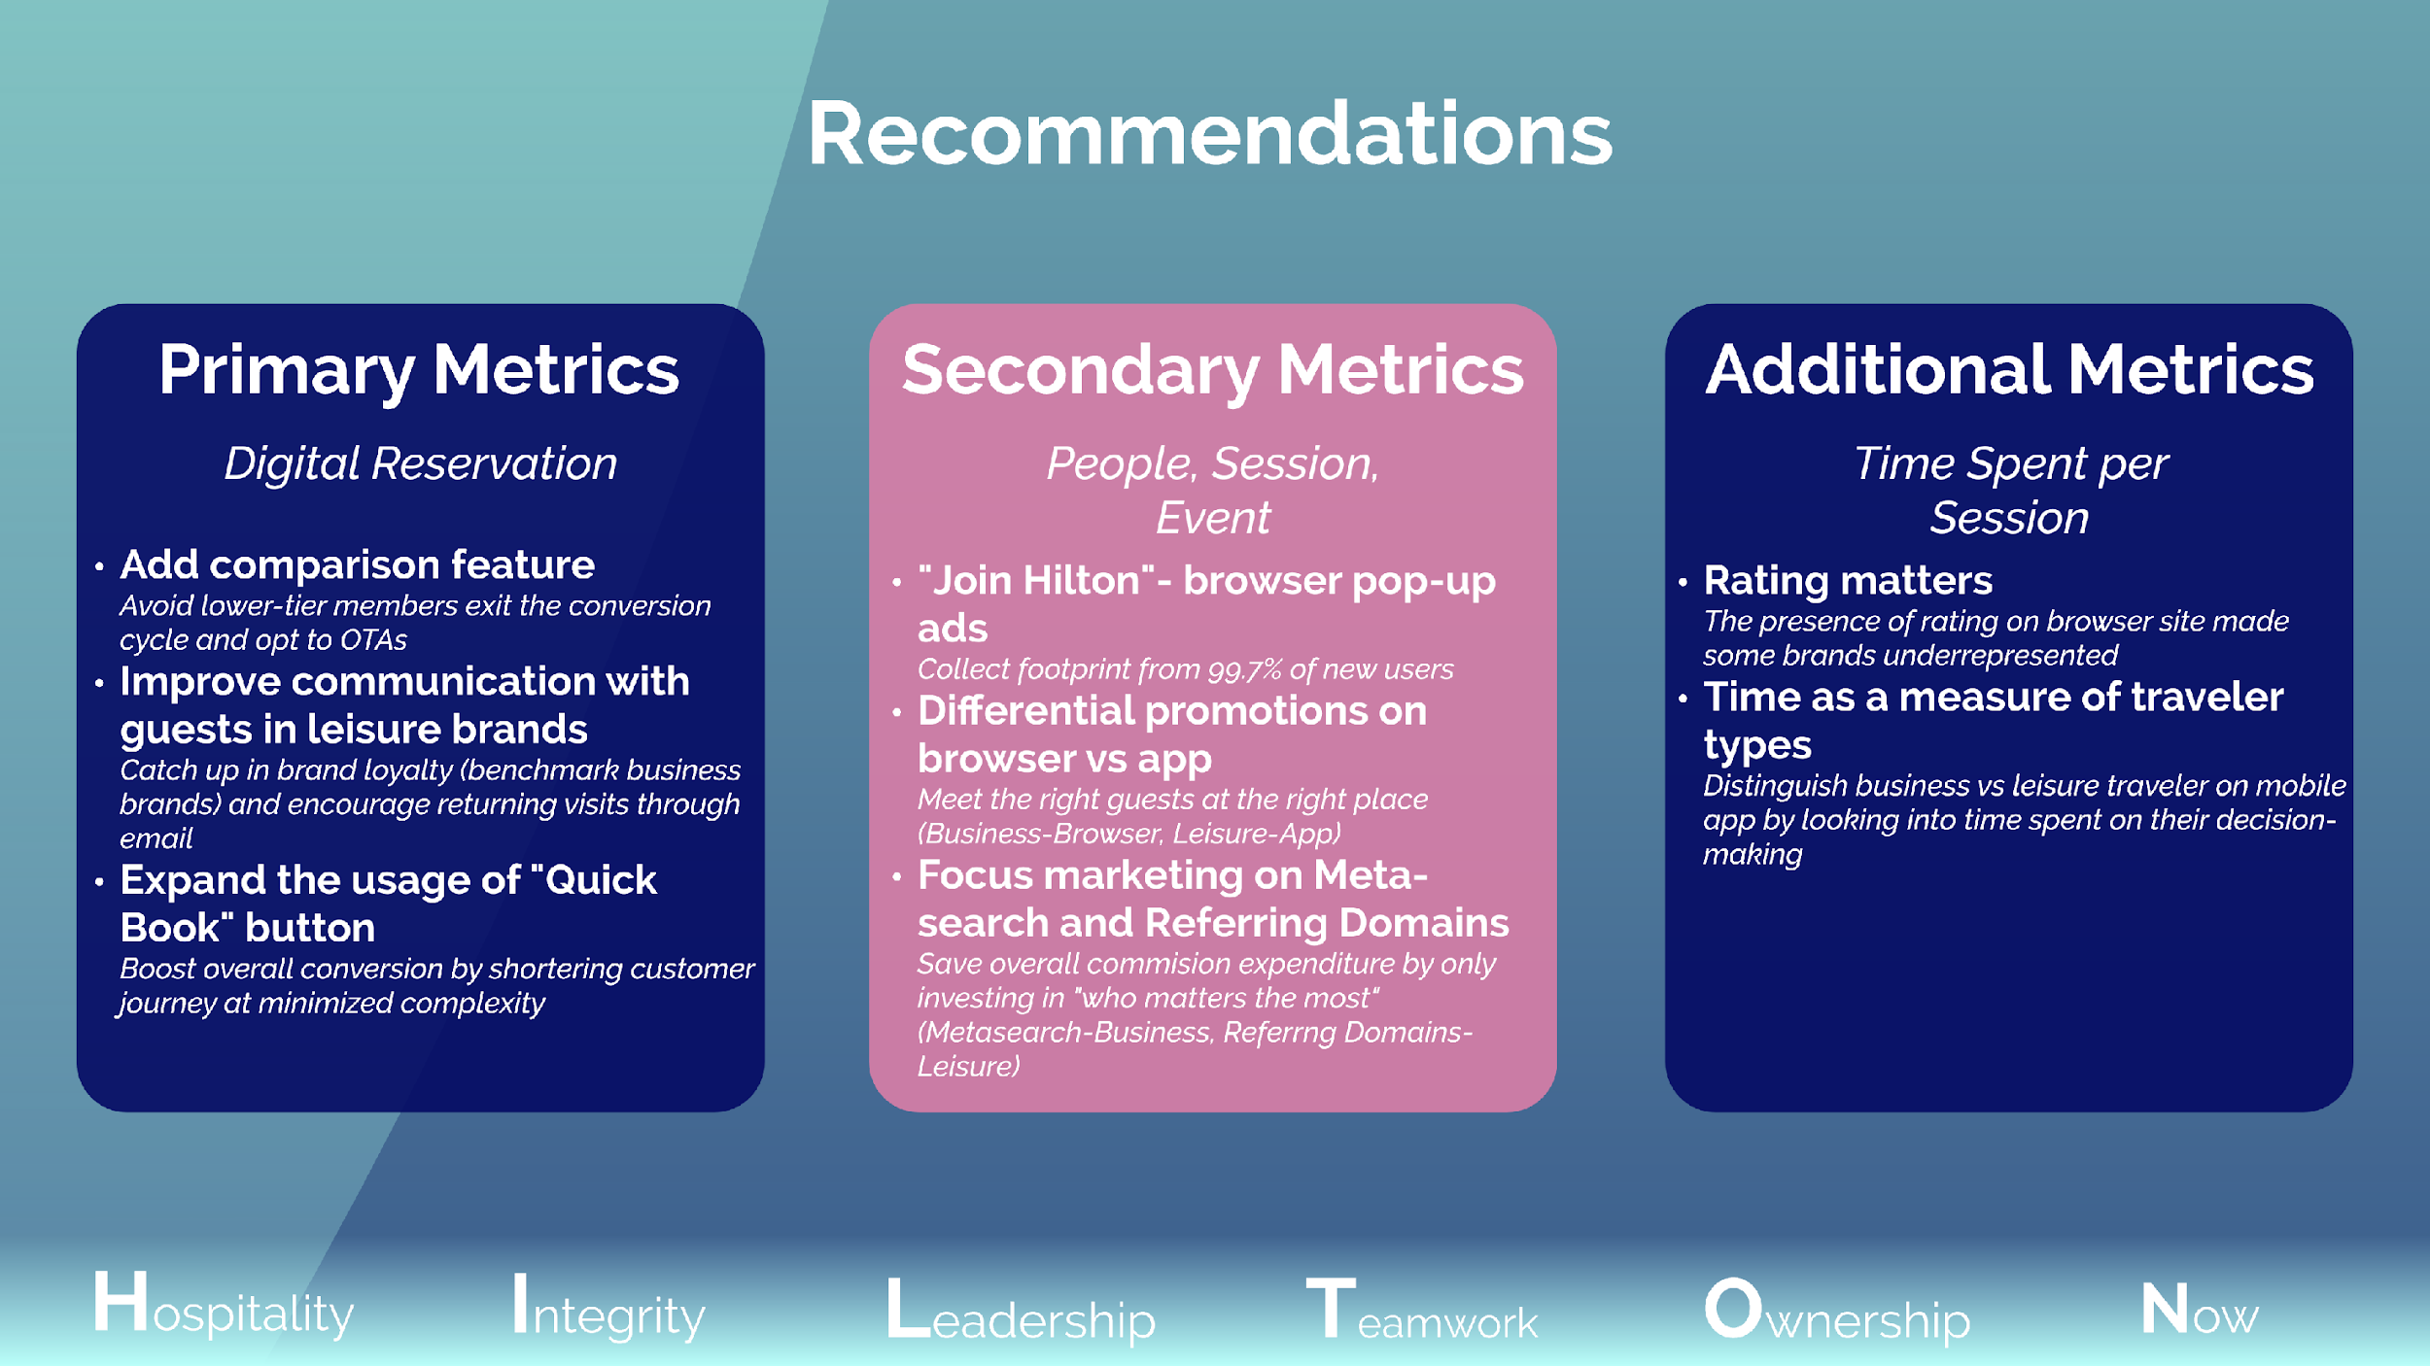
Notes:
We would like to express special appreciations to Adobe and Hilton, and we welcome your questions & suggestions.

